Slide 1
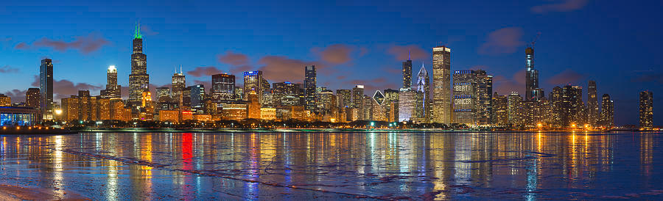
Chicago Crime Data
Group 12
Garret Sooter
Emilio Cabrera
Branda HuanG
Lucas Fernandez

Slide 2
Presentation Agenda
Introduction
Dataset
Exploratory Analysis
Multi-variable linear Regression
Conclusion
Model Overview
Model
YoY Crime Trends
Geographical Interactive Plot
Objectives
Logistic Regression
Summarize Trends

Slide 3

Dataset: Chicago Crime
n = 7.37 million | p = 22
Source:
Extracted from Chicago Police Department's Citizen Law Enforcement Analysis and Reporting system
2001 to Present (except the most recent 7 days)
Reflects reported incidents of crime (non-murder)
Variable Description:
Numeric
ID | Ward
X Coordinate | Latitude
Y Coordinate | Longitude
Year
String
Case # | Location Description
Block | Beat
IUCR | District
Primary Type | Community Area
Description | FBI Code
Unique Variables (Type)
Date (Date)
Updated On (Date)
Arrest (Binary)
Domestic (Binary)
Location (Geographical Location)

Slide 4
Objectives
When is the best time of the year to visit Chicago?
Is there a specific time of day one should tour Chicago?
Did COVID-19 influence crime rates?
Predicting the likelihood of an arrest given various features of the crime committed
Are there certain neighborhoods or streets to avoid in Chicago?
Exploratory
Models

Slide 5
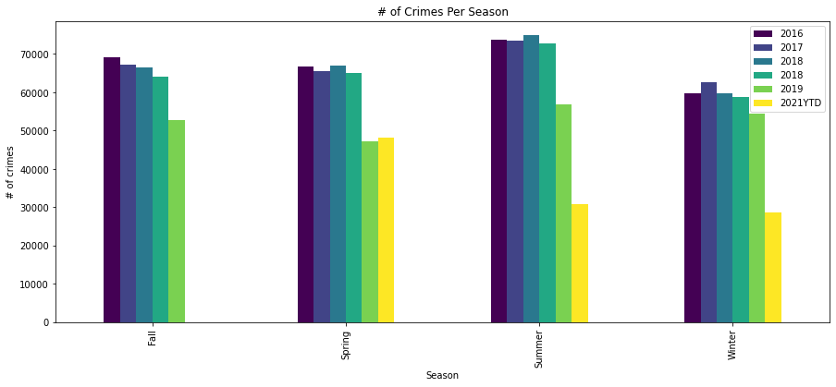
Crime Trends: Season
Season: Months
Winter : JAN, FEB, DEC
Spring : MAR, APR, MAY
Summer : JUN, JUL, AUG
Fall: SEP, OCT, NOV

Slide 6
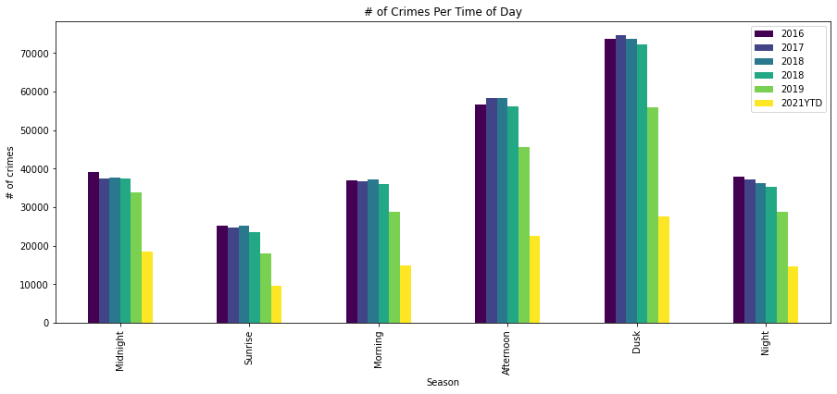
Crime Trends: Time of Day
Time of Day: Range
Sunrise : 5AM – 8AM
Morning : 9AM – 11AM
Afternoon: 12PM – 3PM
Dusk: 4PM – 9PM
Night: 9AM – 11PM
Midnight: 12AM – 4AM

Slide 7
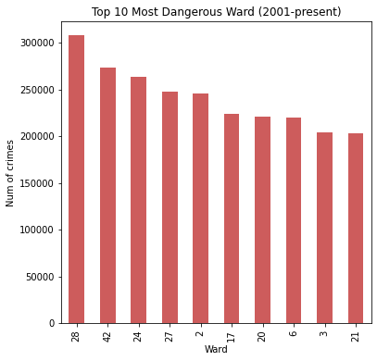
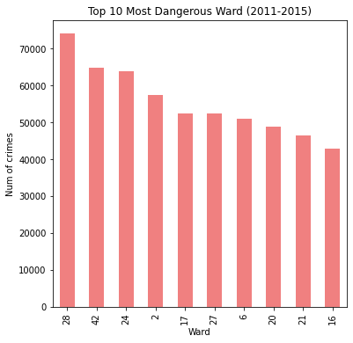
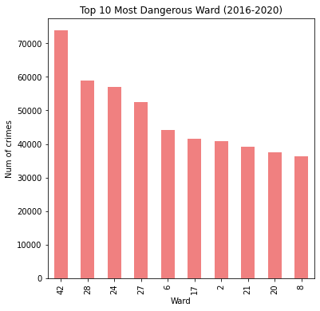
Crime Trends: Most Dangerous Wards
Explore smaller scales of time…
the most dangerous wards seem
to remain notorious over years

Slide 8
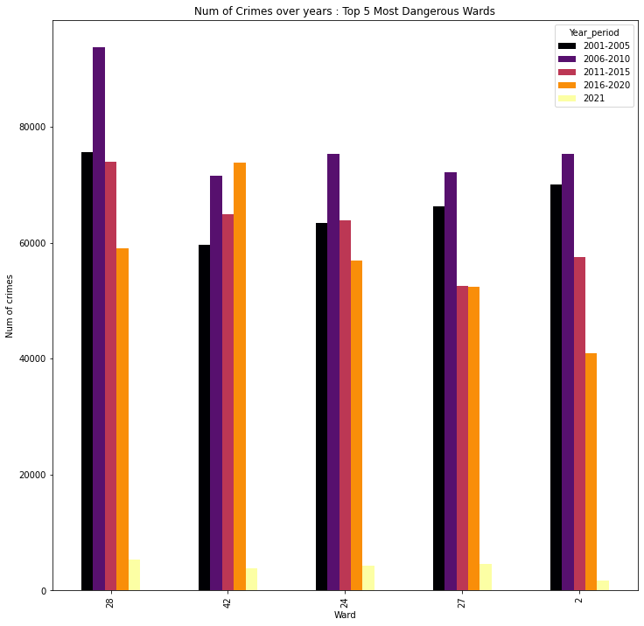
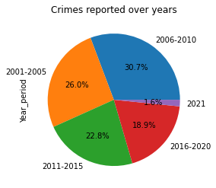
Crime Trends: Changes In Dangerous Wards
32 crimes reported daily in the top 10 most dangerous areas
Fewer crimes reported in 2011-2020 compared to 2001-2010
Most crimes reported in 2006-2010
42nd Ward becomes more dangerous in the past 5 years

Slide 9

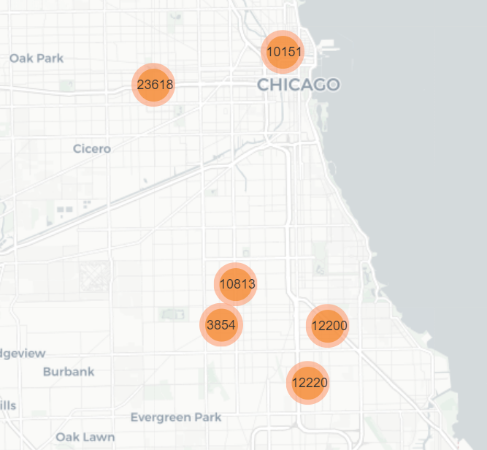
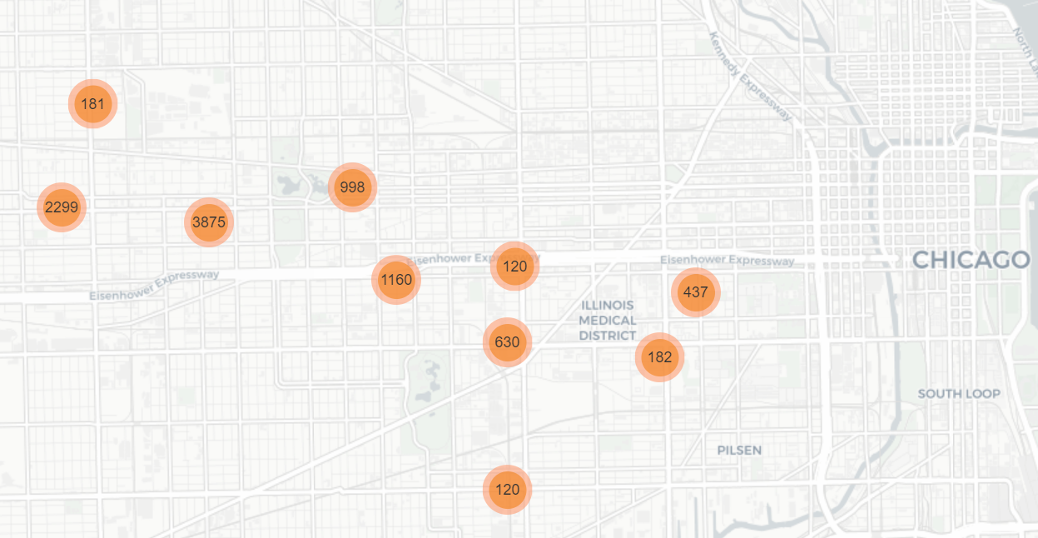
Where Are The Dangerous Streets?
W28 map
https://reurl.cc/KAWdZM
Take a closer look into the dangerous roads in W28
21 crimes reported daily in the top 10 dangerous areas last year
West Garfield Park appears to be the most dangerous area

Slide 10
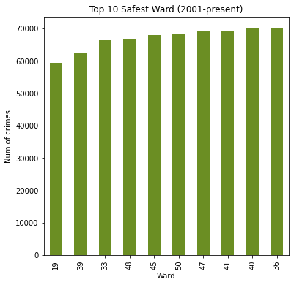
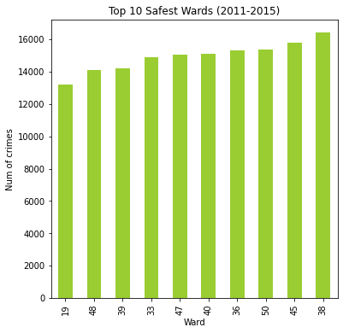
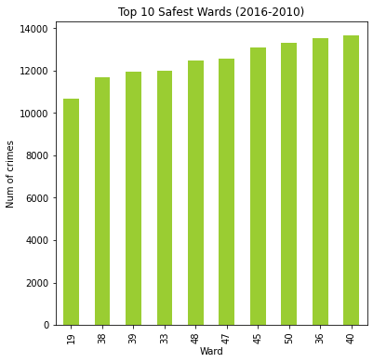
Crime Trends: Safest Wards
Explore smaller scales of time…
Safe wards don’t seem to change much over years,
but 38th ward is getting safer in the past 10 years

Slide 11
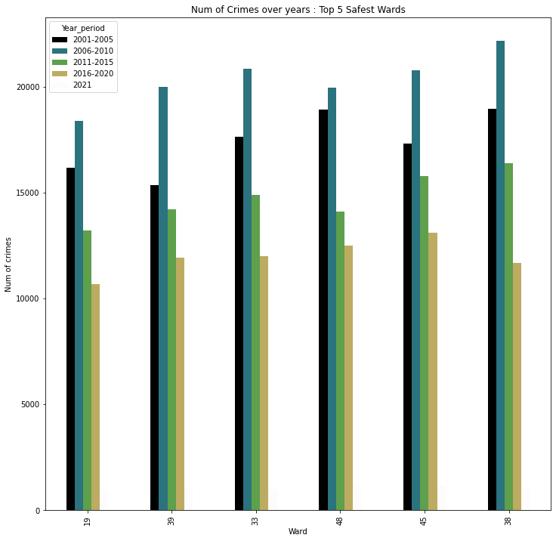
Crime Trends: Changes In Safest Wards
9 crimes reported daily in the top 10 most dangerous areas
Among the safe wards, most crimes still reported in 2006-2010
38th Ward becomes safer in the past 5 years

Slide 12


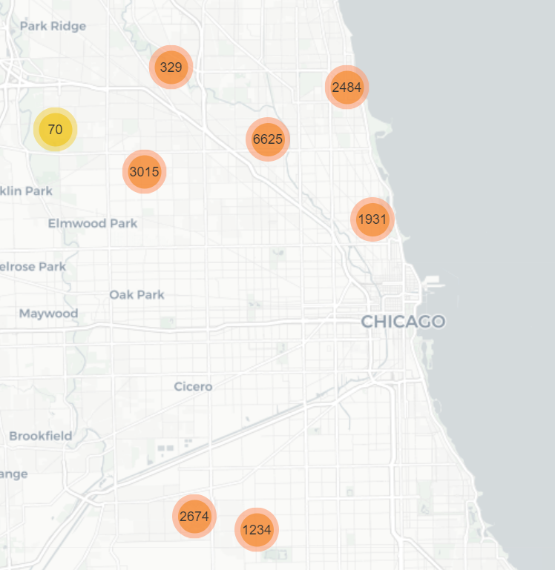
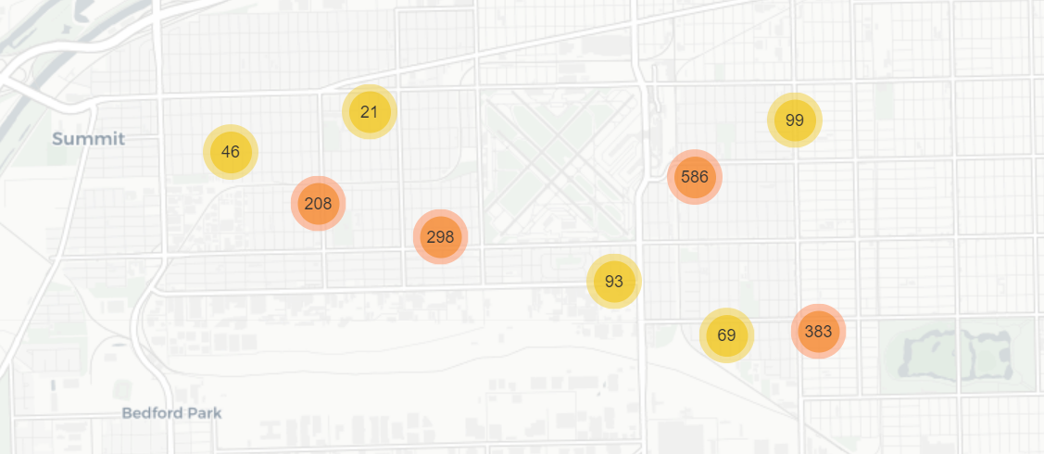
Where Are The Safest Streets?
Safe Wards Map
https://reurl.cc/6amKgO
W13 Map
https://reurl.cc/5rxKgz
Safest streets in W13
W33
W13
6 crimes reported daily in the top 10 safest areas last year
W13 as the safest ward last year looks generally safe

Slide 13
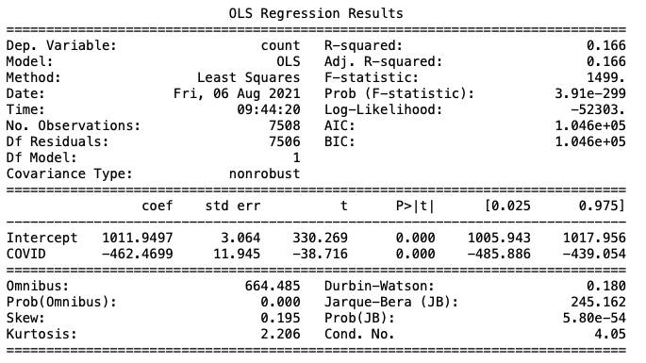
Regressing Crime Rate On COVID
COVID was great for crime!
Did we miss anything?
Average Crime 2001-COVID
1012 Crimes per day
Average crimes COVID-Now
549 crimes per day

Slide 14
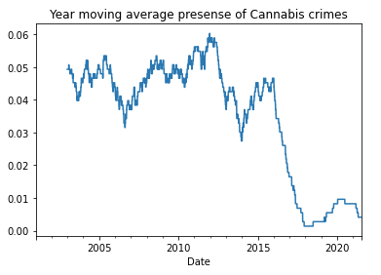
Cannabis Crime Rate Has An Interesting Slope

Slide 15
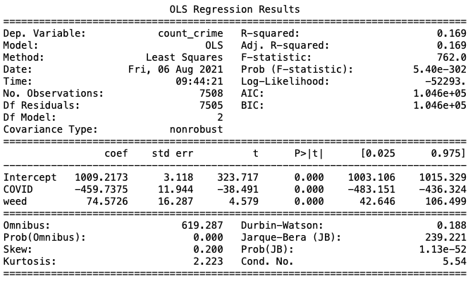
Crime on COVID and Cannabis
New Cannabis Legislation
Control for this
Not a large effect

Slide 16
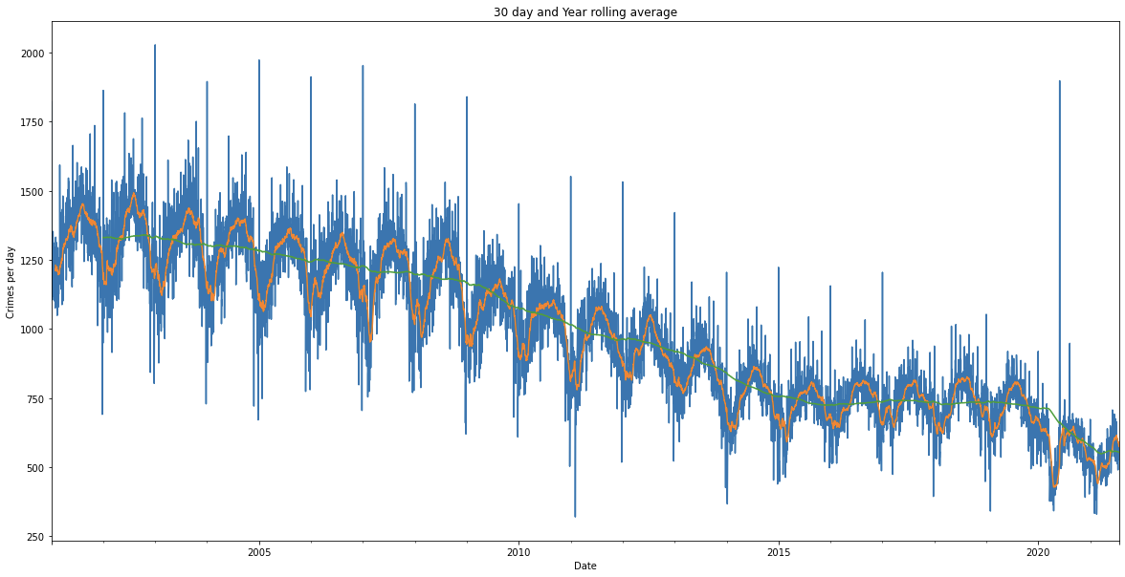
Let's Visualize The Data

Slide 17
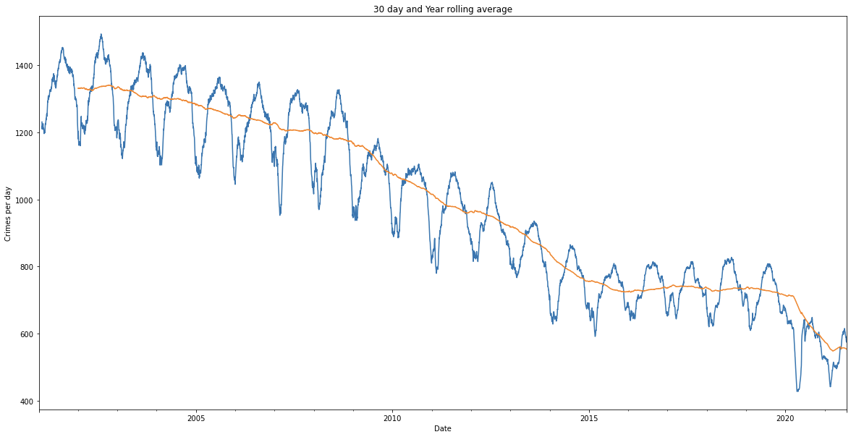
Let's Visualize The Data

Slide 18
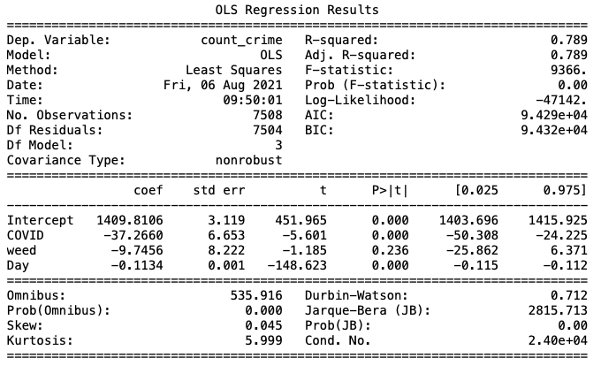
Crime on COVID, Cannabis, and Date
Introduce an instrumental variable
Possible unnecessary variables
Multi-collinearity issues
Average Crimes Per Day (Period):
1,012 (2001 – COVID)
549 (COVID – Present)
1,319 (2001 – 2003)

Slide 19
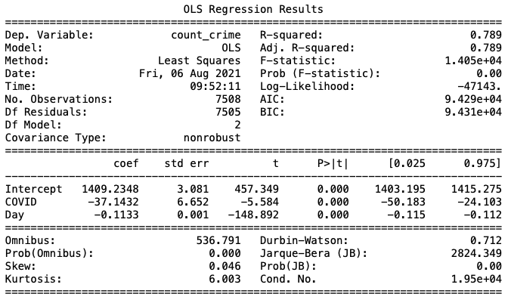
Crime on COVID and Day
"Day" controls for everything
Culture shifts
Socioeconomic trends
Weed legislation
Time trend ≠ COVID
Large percent of variation explained

Slide 20
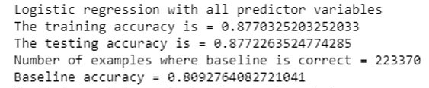
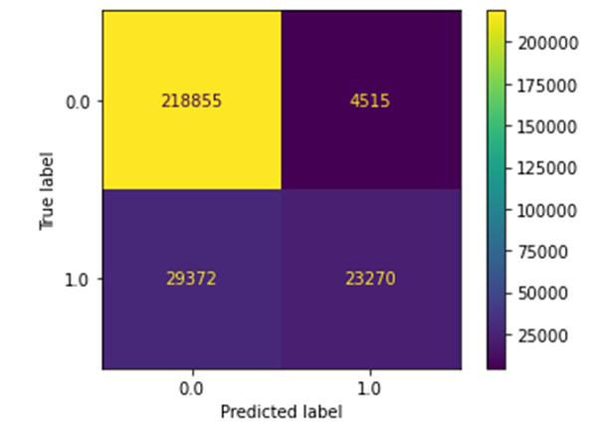
Logistic Regression: Model & Confusion Matrix
Arrest ~ Type + Location Description + District + Time of Day
Transformed all features into list of dummy variables
Set an intercept of 0 to get coefficients for all dependent variables
Increased max iterations
Large amount of negative class values (no arrest made)
High false negative rate: 29372 were arrests that are predicted as not arrests
Low false positive rate: only 4515 were predicted as arrests

Slide 21
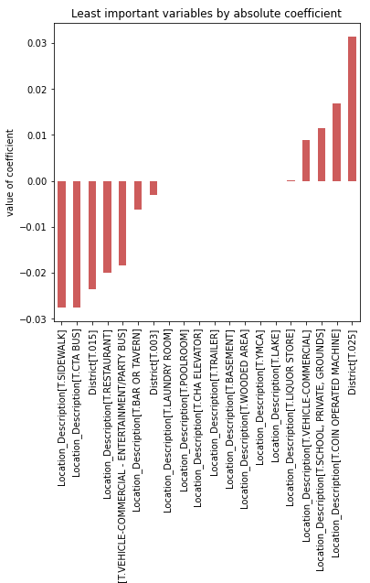
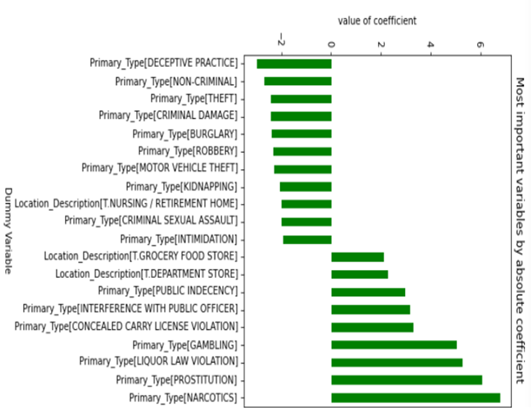
Logistic Regression: Variable Importance
Low-Impact
Victimless
Many location descriptions only have an average arrest rate
Location description has a high variance in the level of impact on arrest rate
Time of day has some impact but not a large impact
Features with greatest impact are primary type and location description

Slide 22
Conclusion
When is the safest time of the year to visit Chicago? Winter>Spring>Fall>Summer
Is there a specific time of day one should Chicago? Sunrise>Morning>Night>Midnight>Afternoon>Dawn
Which wards have the highest/lowest crime rates? Safest(13 & 33) / Dangerous(28)
Regression Model (Type) | Interpretation
Crime ~ COVID (Linear) | ~50% drop in crime, not much explained
Crime ~ COVID + Cannabis (Linear) | ~50% drop in crime, a bit more explained
Crime ~ COVID + Cannabis + Date (Linear) | ~7% drop in crime, multi-collinearity
Crime ~ Date (Linear) | ~7% drop, ~80% variance explained
Arrest ~ Type + Location Description + District + Time of Day (Logistic) | Arrests dependent on type of crime

Slide 23
Thank You!
Questions?

